Slide 1

Forecasting Methods
“Plan is nothing, however, planning is everything.”

Slide 2
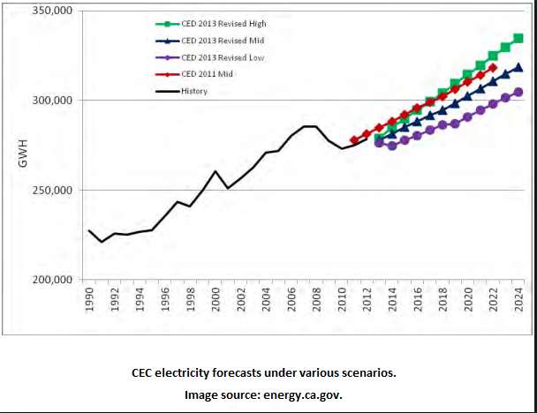
Rule of Thumb
“Make use of reputable studies from other institutions.”

Slide 3

Forecasting
  : the process of making predictions of the future based on past and present data and most commonly by analysis of trends
  Qualitative forecasting methods
    Delphi, Forecast by analogy
    Market survey
  Quantitative forecasting methods
    Time-series analysis: Moving average, Exponential smoothing,
    ARIMA(Autoregressive Integrated Moving Average)
    Causal methods: Regression Analysis, Econometric Models
    Diffusion Curve : Logistic, Bass Models
  Artificial Intelligent methods
    Datamining, Pattern Recognition
    Machine Learning

Slide 4


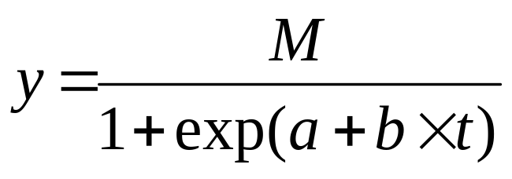





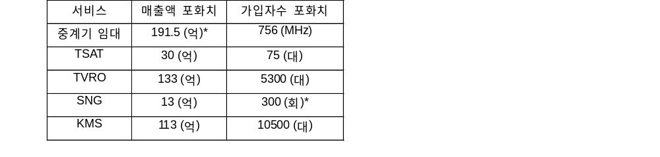
Service Forecasting(An example)
Revenue, #_of_Subscribers of 7 satellite services : Historic Data
(yes)
(no)
Time series Regression Model
⋅ Logarithmic model :
⋅ Inverse model :
⋅ Power model :
⋅ Compound model :
⋅ S model :
⋅ Growth model :
⋅ Exponential model :
Logistic Model
Saturation Point
- KT people (Inside personnel)
- Analyzers(Outside personnel)
Saturation Points (M)
Check Significance
- Optimistic
- Average
- Pessimistic
(* : 한국통신의 예측값을 연구자 의견을 반영해 조정)

Slide 5
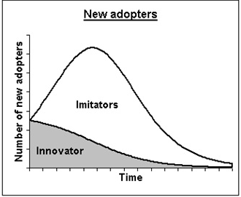
Diffusion Model
  Process of how new products and services move in the market or get adopted by consumers as an interaction between present customers and potential customers.
  the adopters of a product are influenced by two channels-Advertising & Word of Mouth
Cumulative (N)
Time

Slide 6
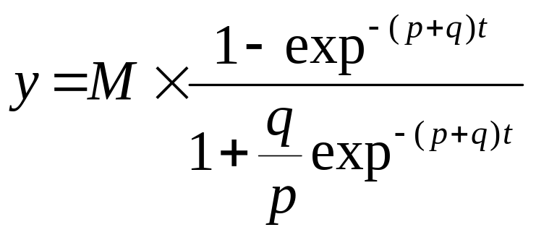
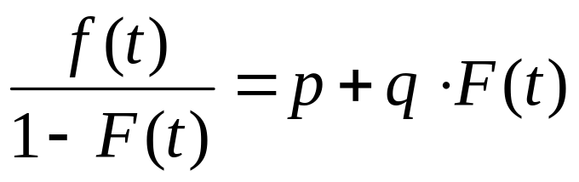
Logistic Model
Bass Model
presents a rationale of how current adopters and potential adopters of a new product interact
adopters can be classified as innovators and as imitators
the speed and timing of adoption depends on their degree of innovativeness and the degree of imitation among adopters.

Slide 7
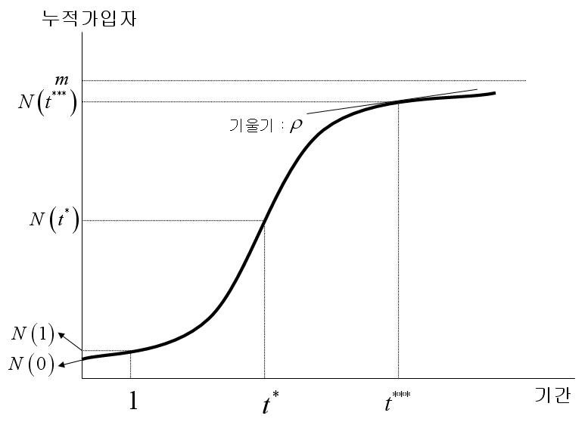







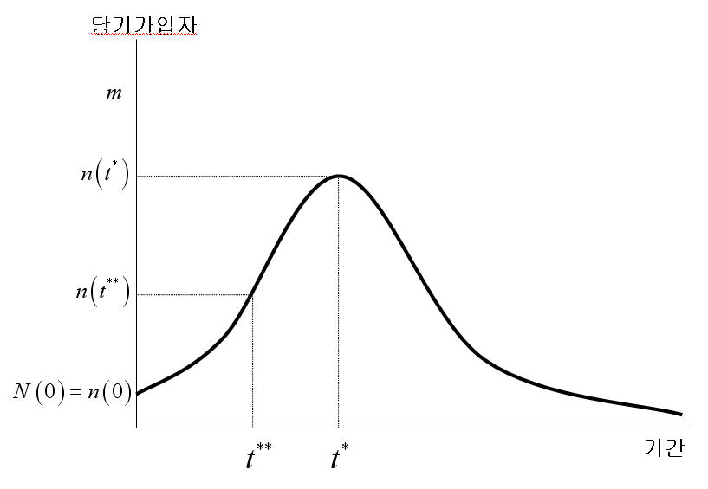




Diffusion Model
Good for New technology forecasting
  Graph
    : Pt. of Max. net users
    : Saturation Pt.
    : Saturation rate
    : Inflection Pt.

Slide 8
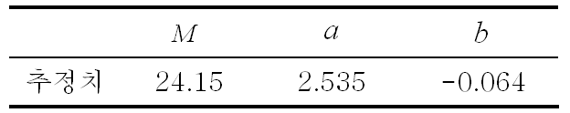
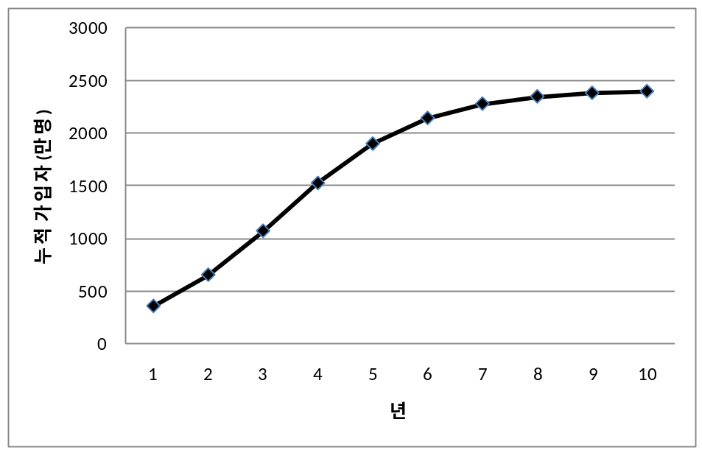
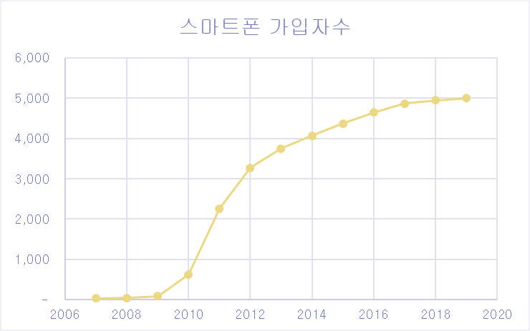
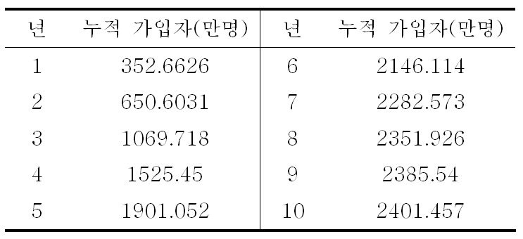

Diffusion Model
An Example
  Terrestrial DMB subscriber forecasting
  (※ cf. 50M smartphone subscribers as of 2019, 5G??)

Slide 9
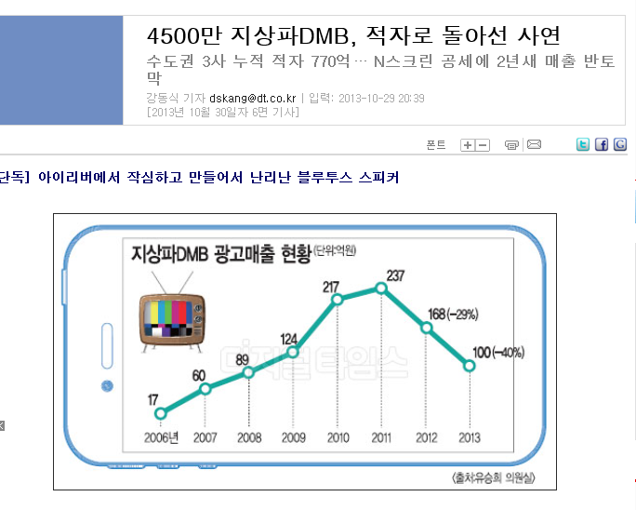



Slide 10
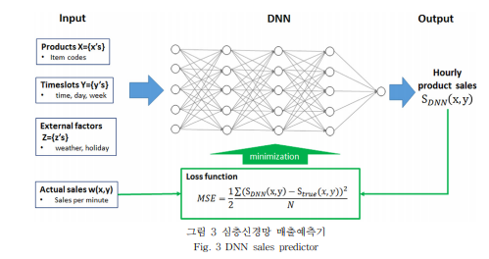
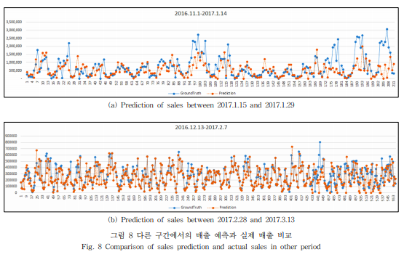
DNN Example
<number>/62

